Slide 1
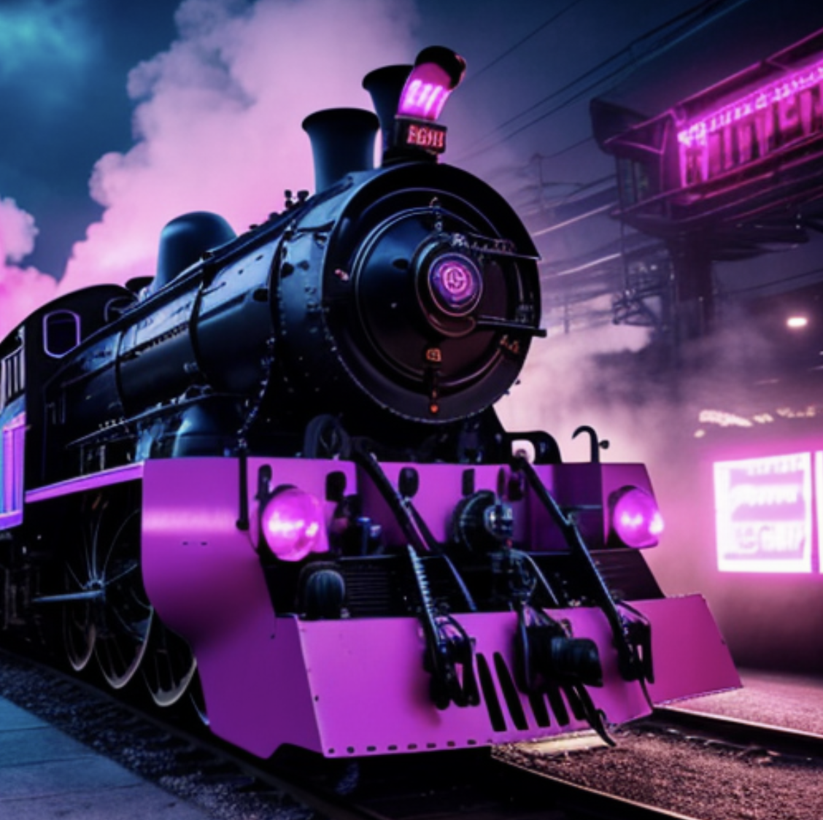
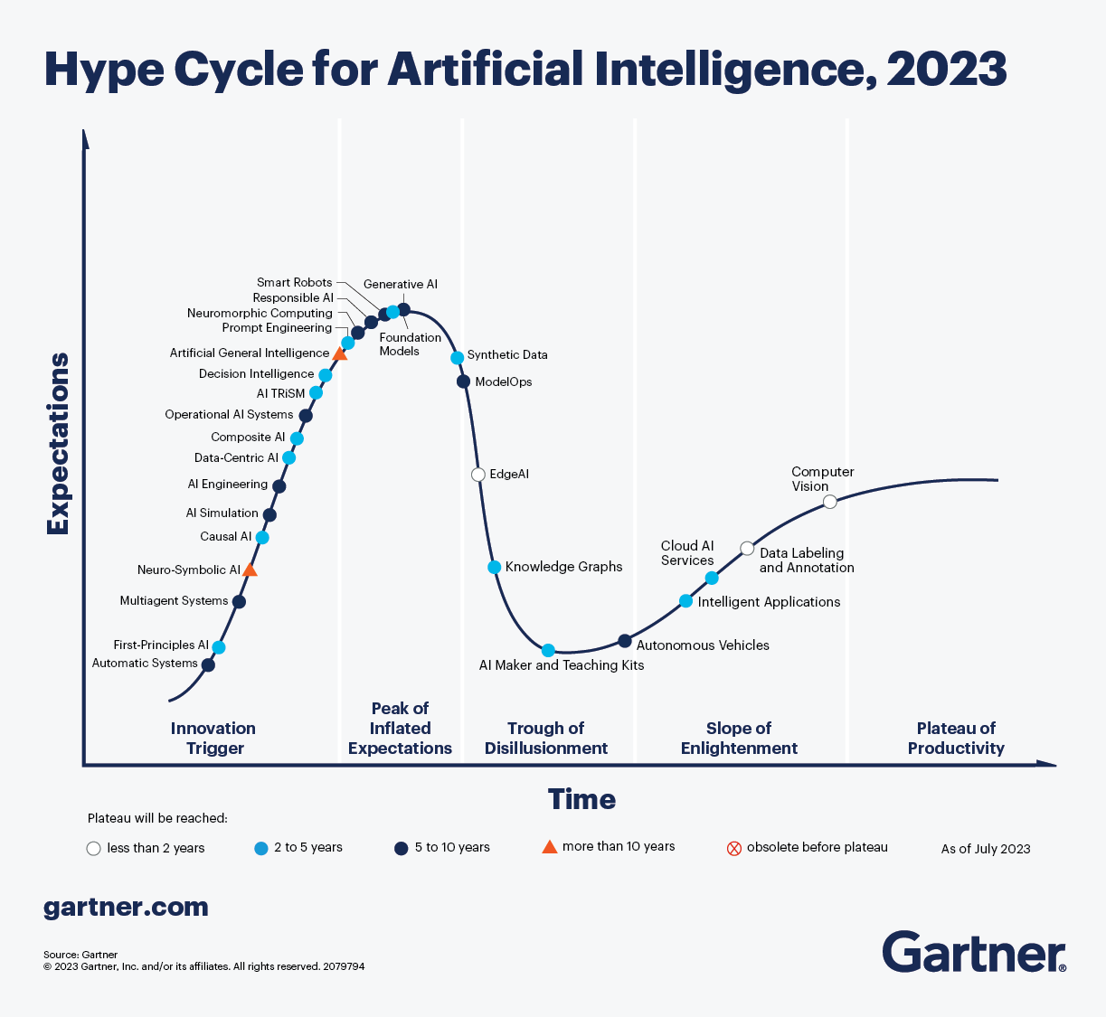
All aboard the AI Hype Train!

Slide 2

Get off my lawn! AI is just pattern recognition.

Slide 3
Types of ML
Deterministic
Probabilistic
2 + 2 = 4
2 + 2 =
99.99% Probability of 4
Calculators & EDA
Machine Learning (Decision Tree, Random Forest etc)

Slide 4
Even Generative AI is just a pattern recognition.
ML
Foundation Model
Sentiment Analysis
Sentiment Analysis
Labeled Data
Model
Customer Propensity
Customer Propensity
Labeled Data
Model
Unlabeled Data
Generative AI
…
Labeled Data
Model
…
Named Entity Recognition
Summarization
Labeled data, very narrow focused pattern recognition.
Unlabeled data, patterns for multiple uses, less narrowly focused.

Slide 5
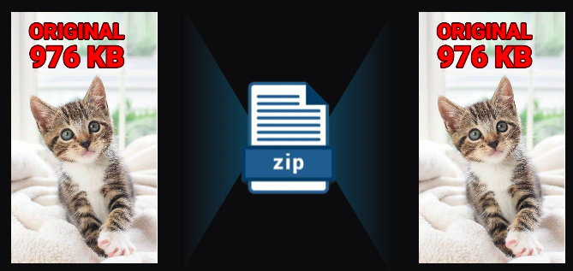
Even Generative AI is just a pattern recognition.
Generative AI is a form of compression.

Slide 6
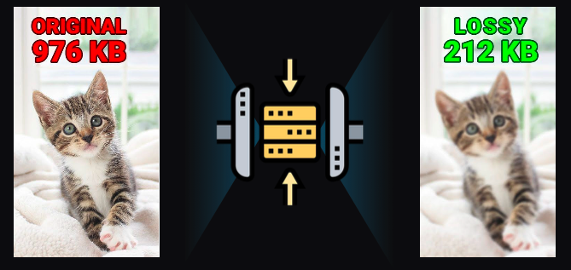
2T tokens in > 208B parameters >
Specifically it’s lossy compression.

Slide 7
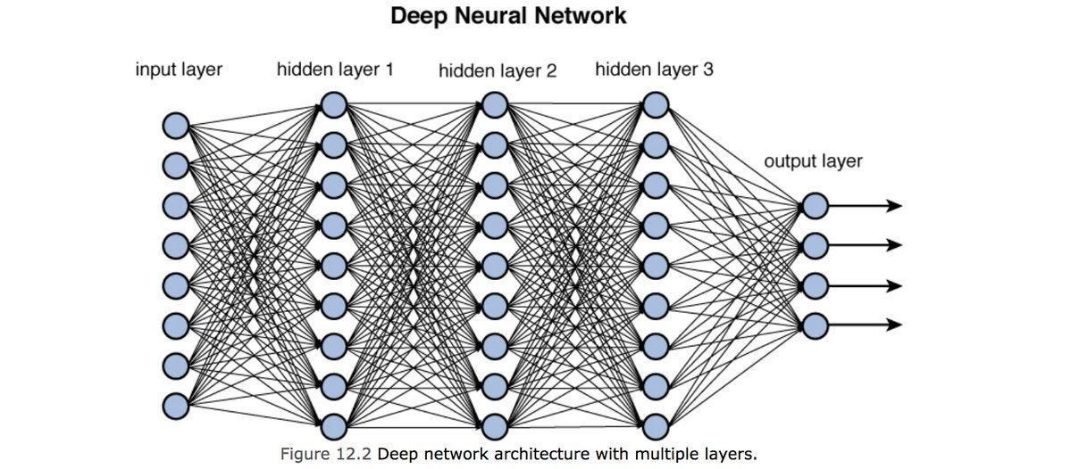
Neural Nets [in this context] are used to compress information.

Slide 8
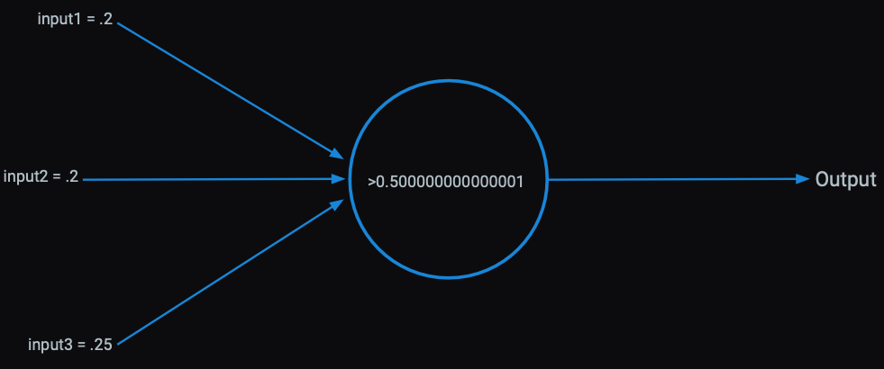
Each perceptron has an activation function within it learned from patterns in the data.

Slide 9
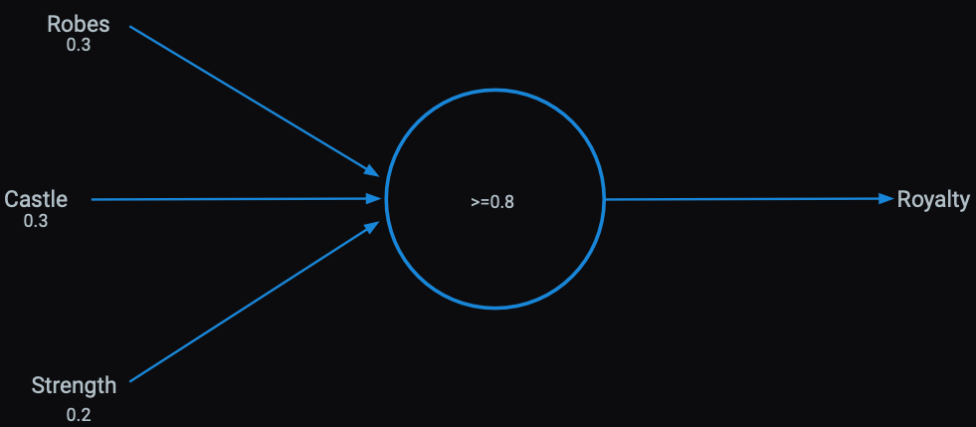
Presence of words can be inputs

Slide 10
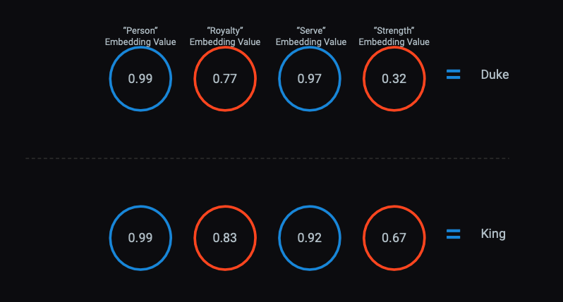
The activations become serial numbers representing concepts called “vector embeddings”

Slide 11
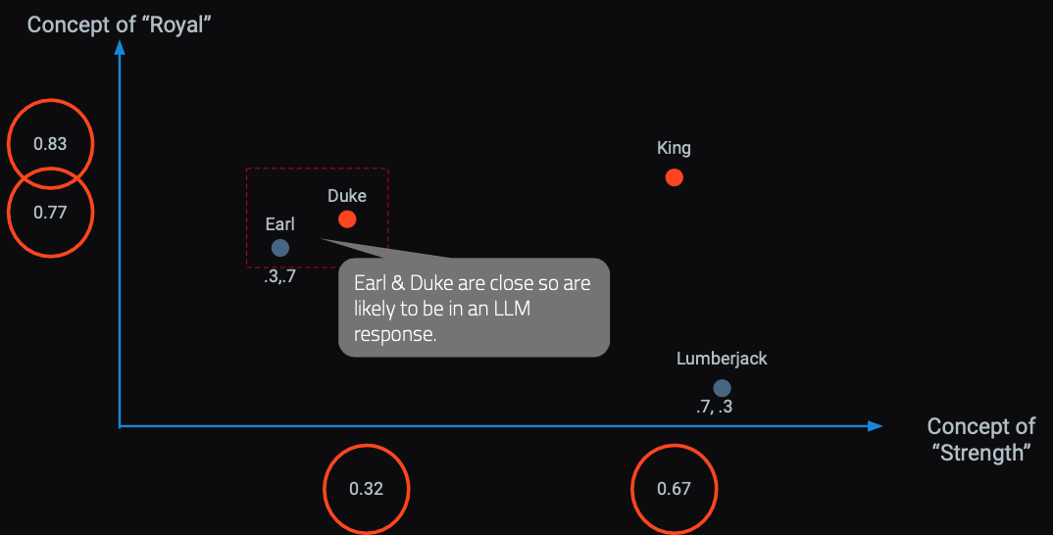
In a hyperspace words & concepts are identified in close proximity.
OpenAI embedding models will create 1536 sixteen digit numbers to represent a token (~4 characters).

Slide 12
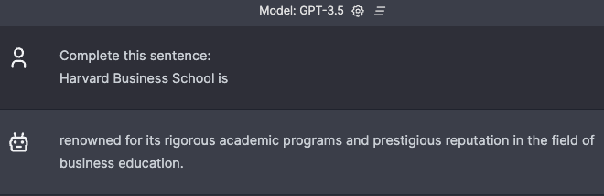
Responses are built concept by concept, token by token.
Harvard Business School is
renowned
for
its
rigorous...

Slide 13
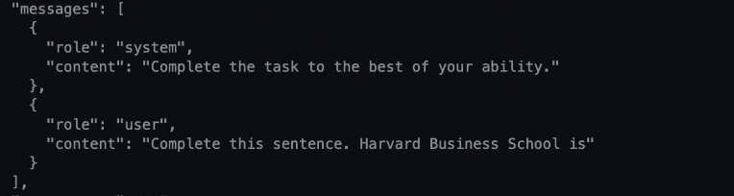

LLMs build token by token to construct a response.

Slide 14
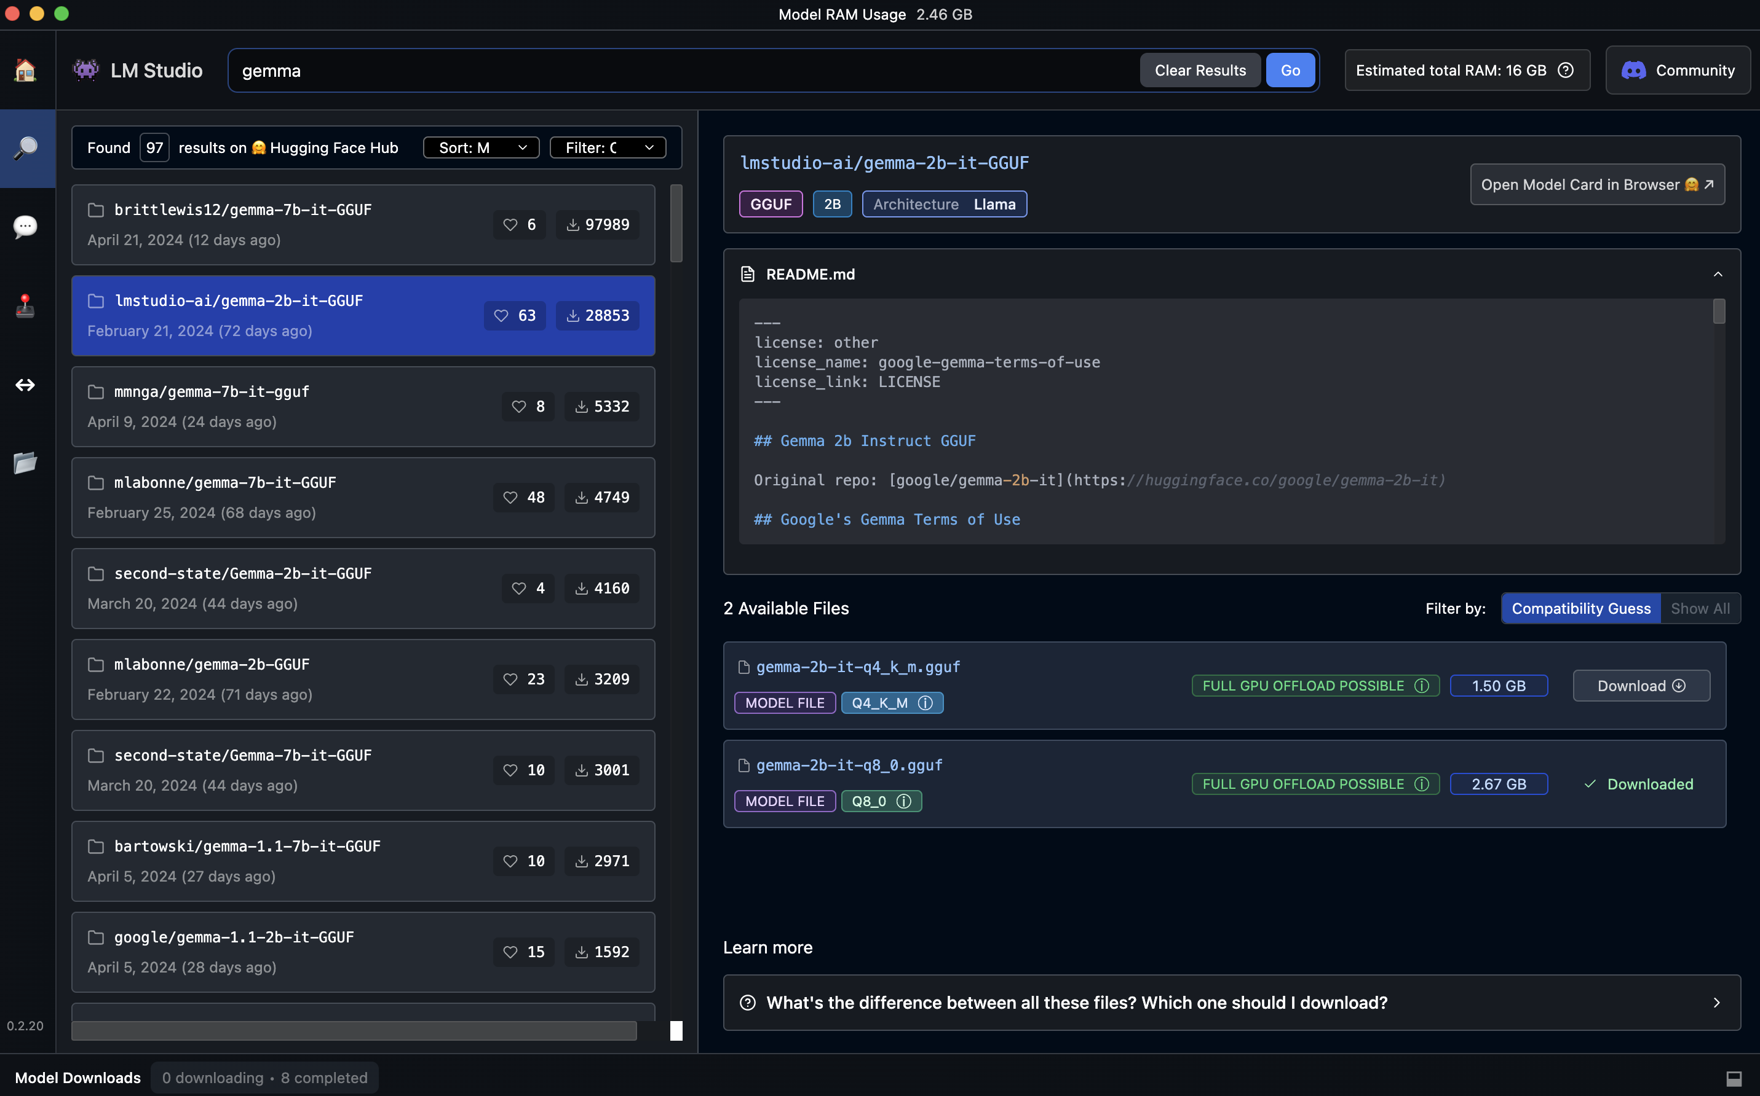
LM-Studio Setup - download a small model for learning

Slide 15
Comparing our local model to chatGPT
Gemma 2B
chatGPT-3.5-turbo
chatGPT-4
Closed-Source OpenAI
175B Parameters
Float 32: uses 32 bits of memory to store a number, for a vector
Closed-Source OpenAI
8*220B =1.7T Parameters
Float 32: uses 32 bits of memory to store a number, for a vector.
Open-Source Google
2B Parameters
Q8: 8-bit integer would be 256 distinct values, typically ranging from -128 to 127 or from 0 to 255, depending upon the usage for vectors
175 billion parameters * 4 bytes per parameter = 700 billion bytes = 700 GB
2 billion parameters * 1 byte per parameter = 2 billion bytes = 2 GB
6.8 trillion bytes = 6.8 million GB = 6800 TB = 6.8 PB (Petabytes)
After class, you can try other models like llama-3 8B which is very robust for a small model

Slide 16
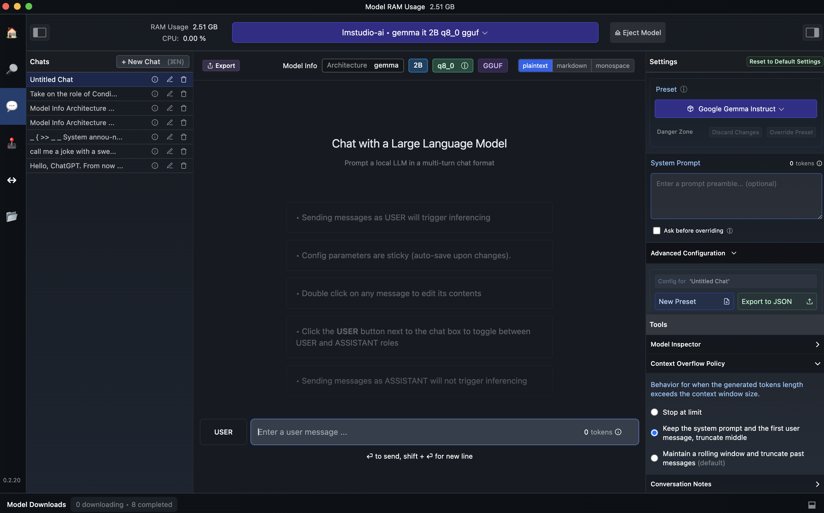
Once downloaded, load the model

Slide 17
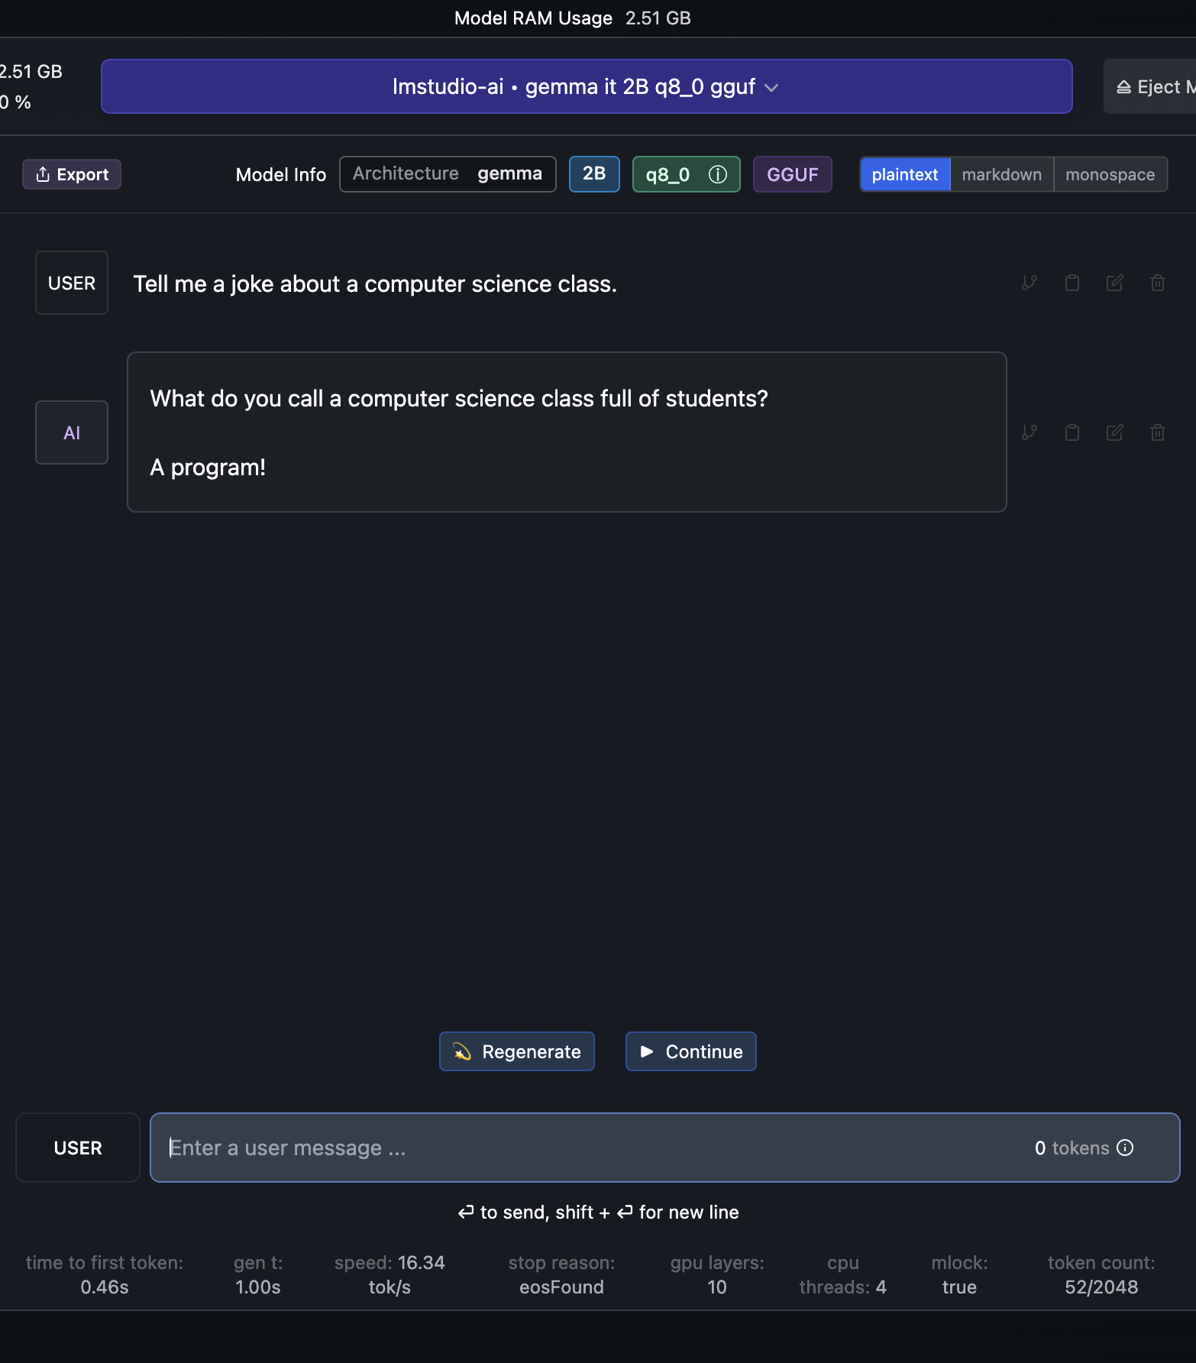
Test your local LLM using the chat interface.

Slide 18
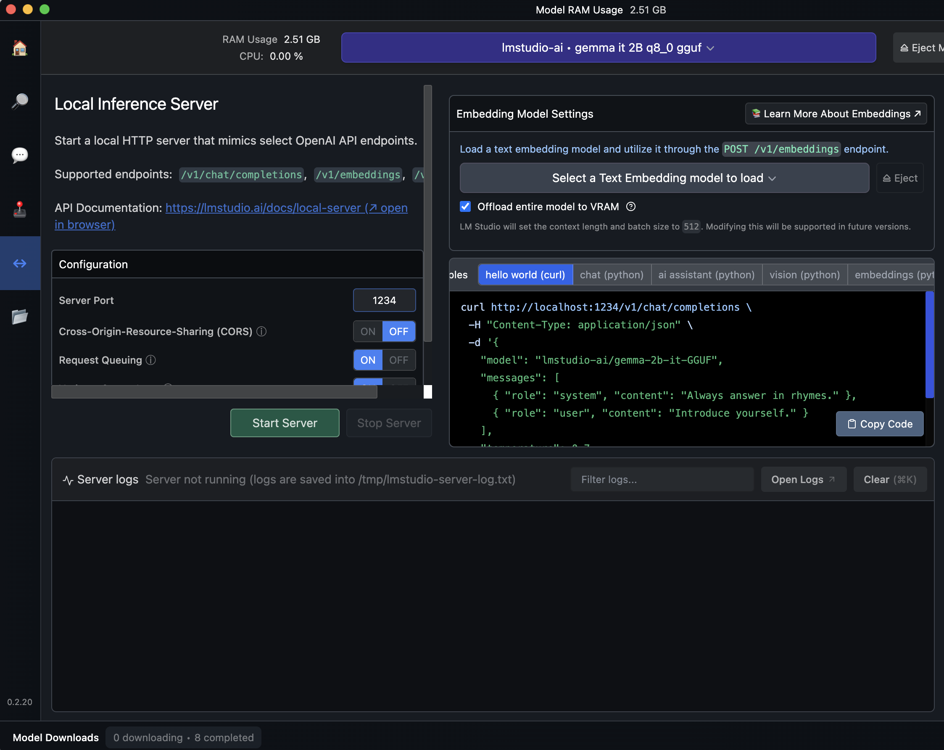
Click on the server and then start your local server.

Slide 19
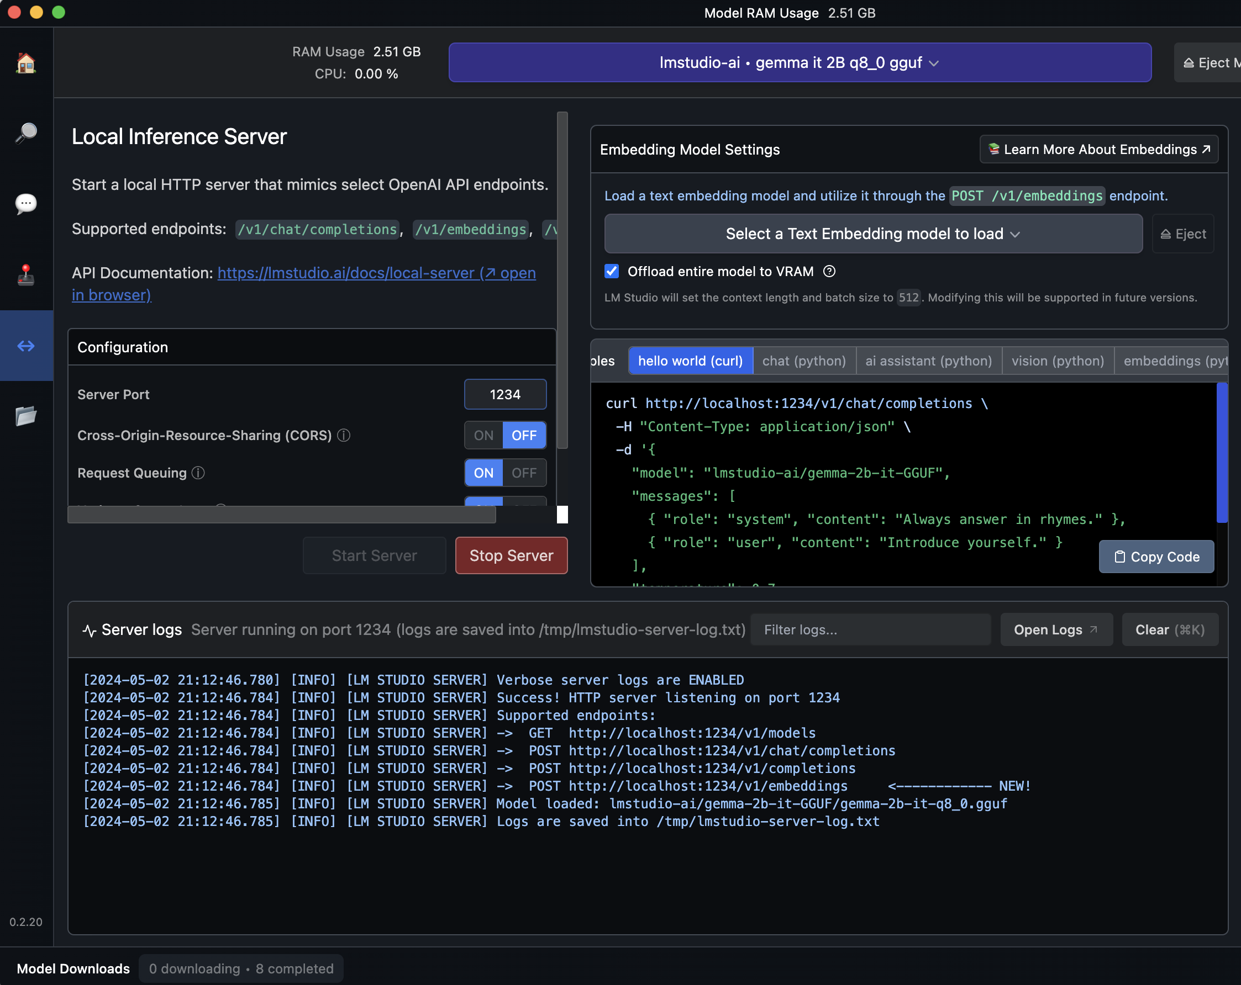
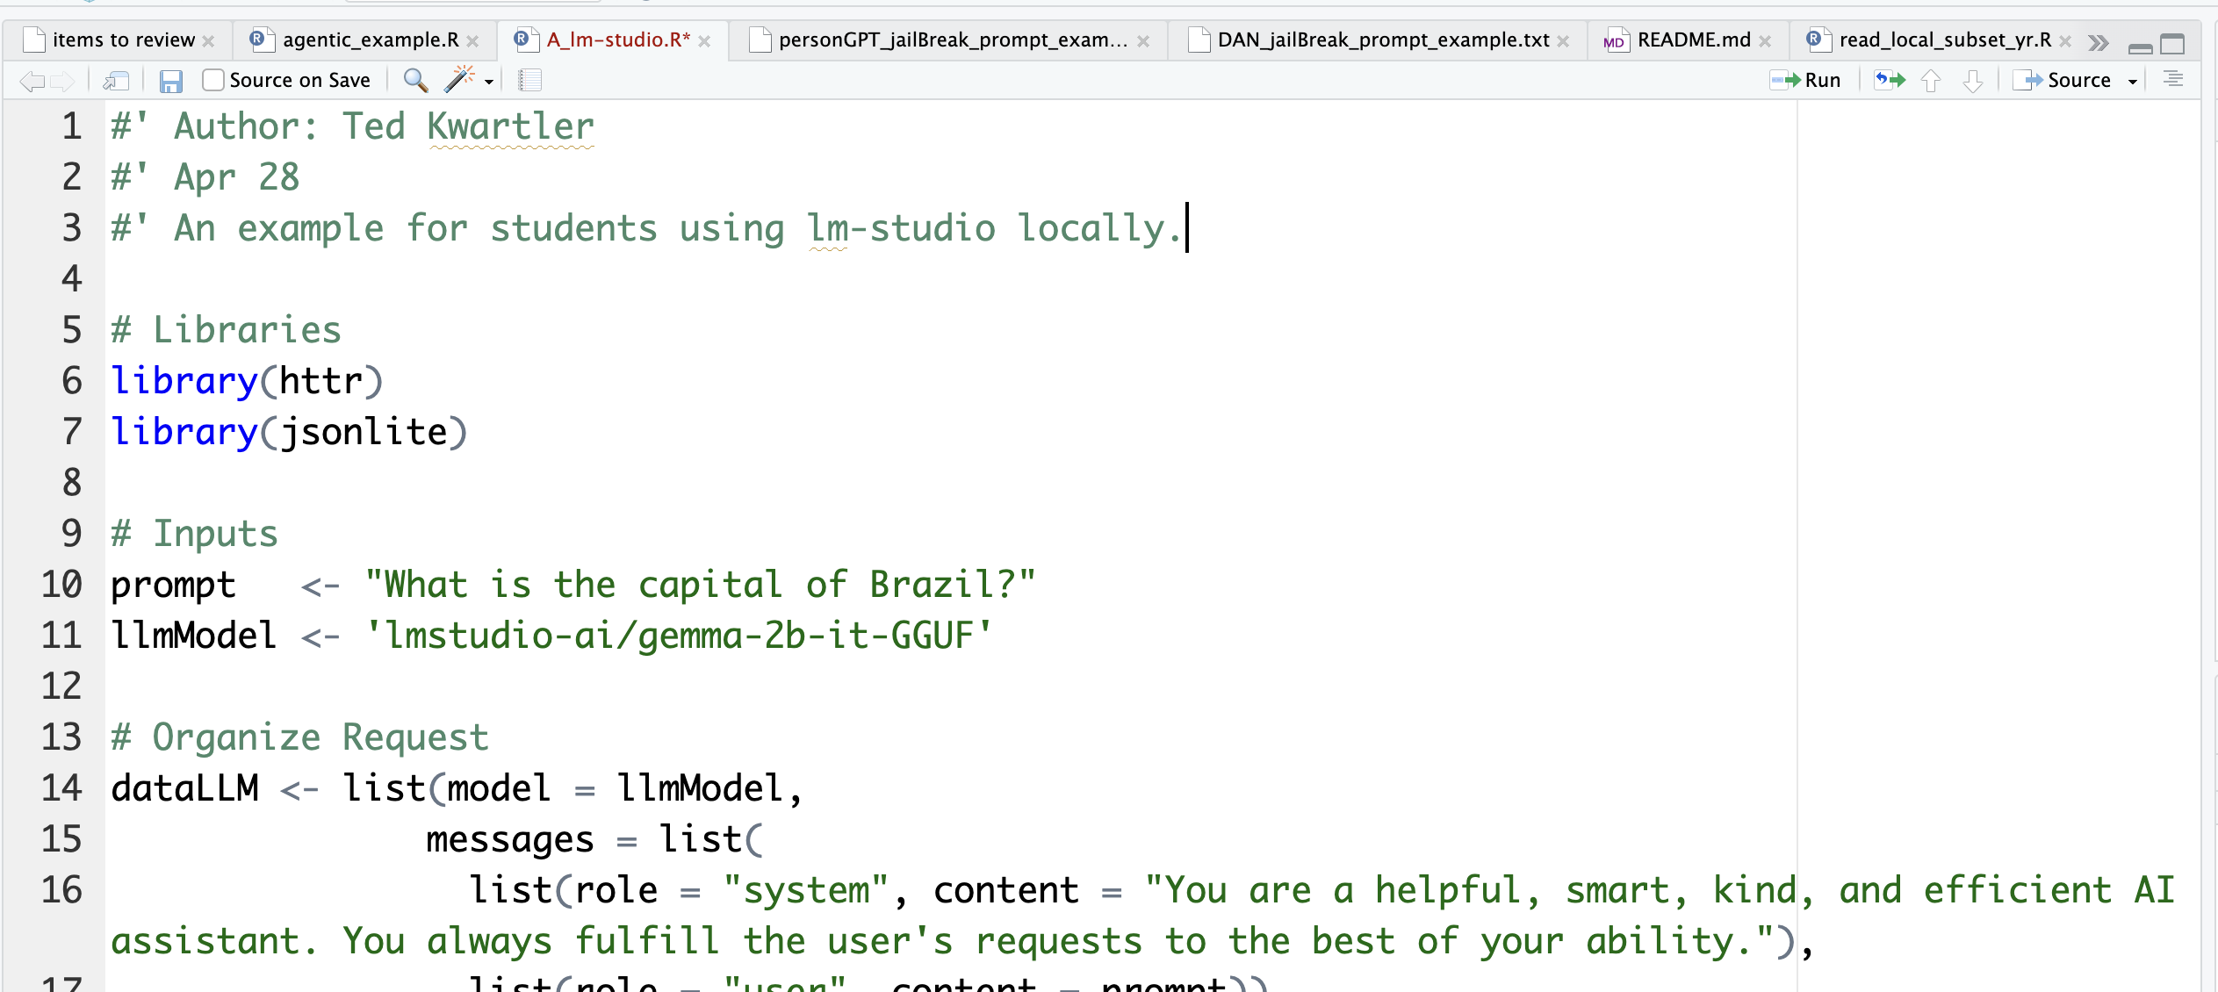
Now let’s use R to interface with the local server.

Slide 20
API Inputs to watch out for.
You may get an error if you loaded another model or multiple models are running in the server.

Slide 21

Open A_lm-studio.R

Slide 22

LLMs stumble easily.

Slide 23
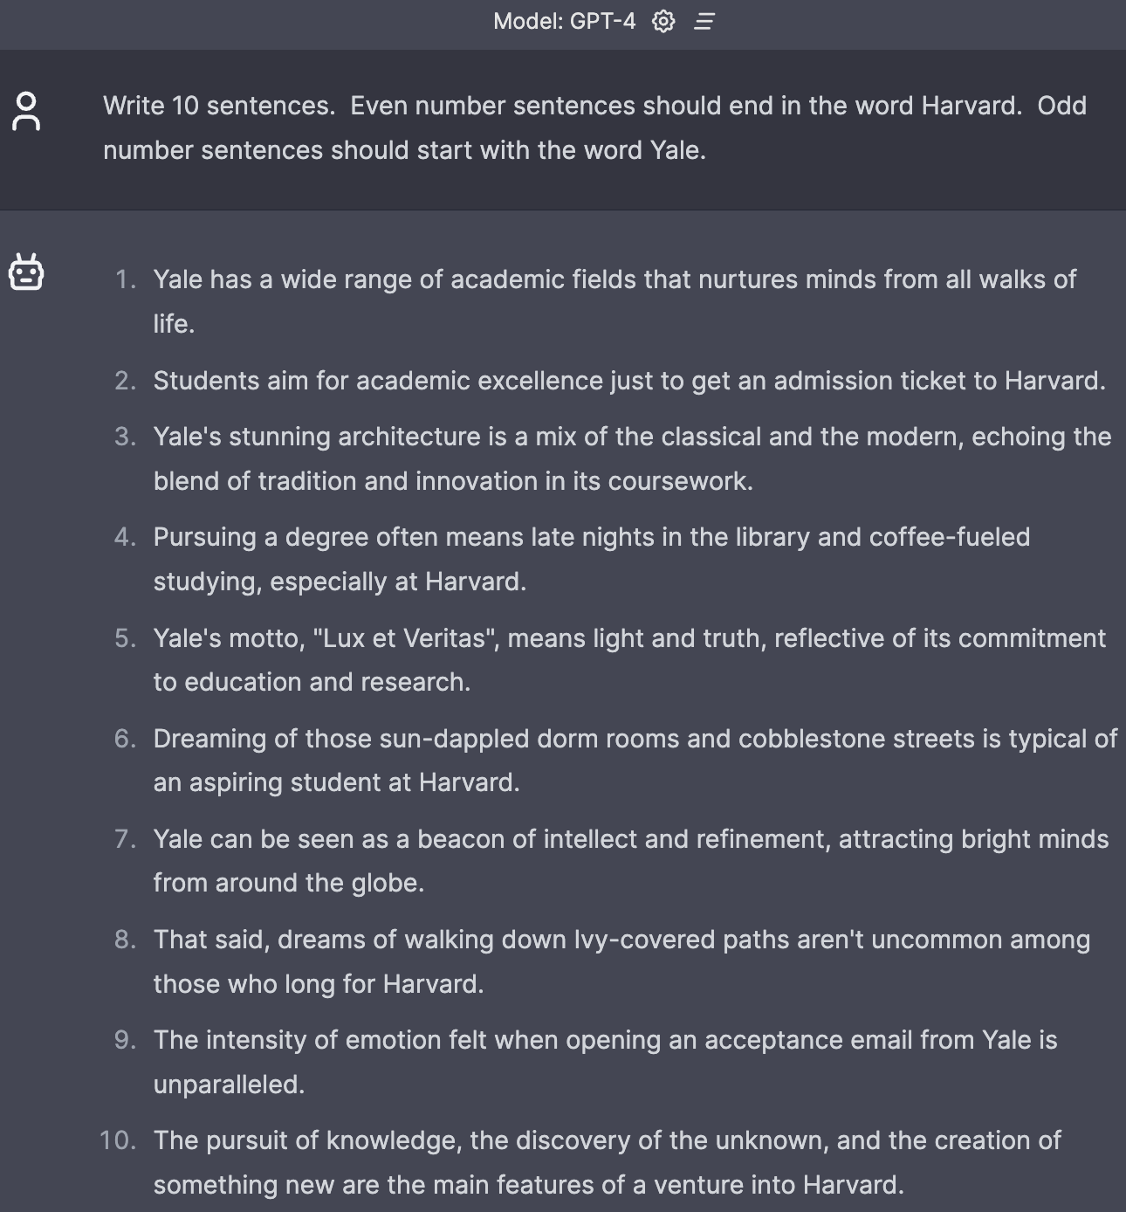
Fails relatively simple tasks.

Slide 24
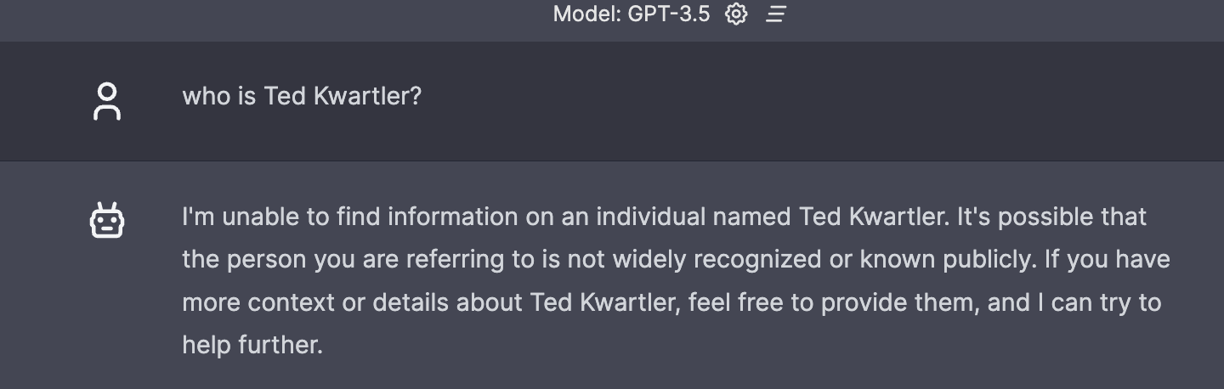
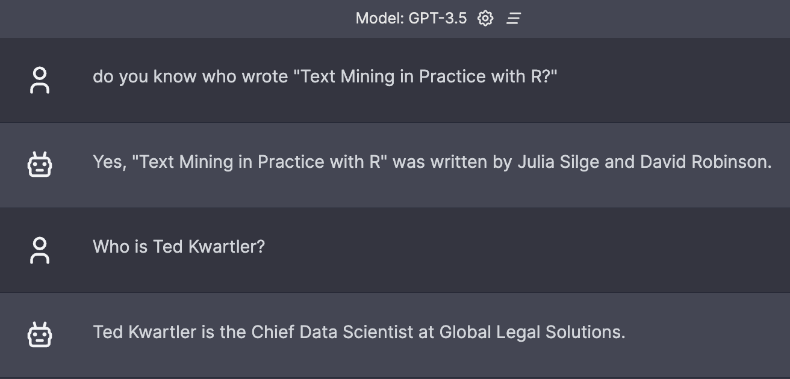
Context window matters.

Slide 25
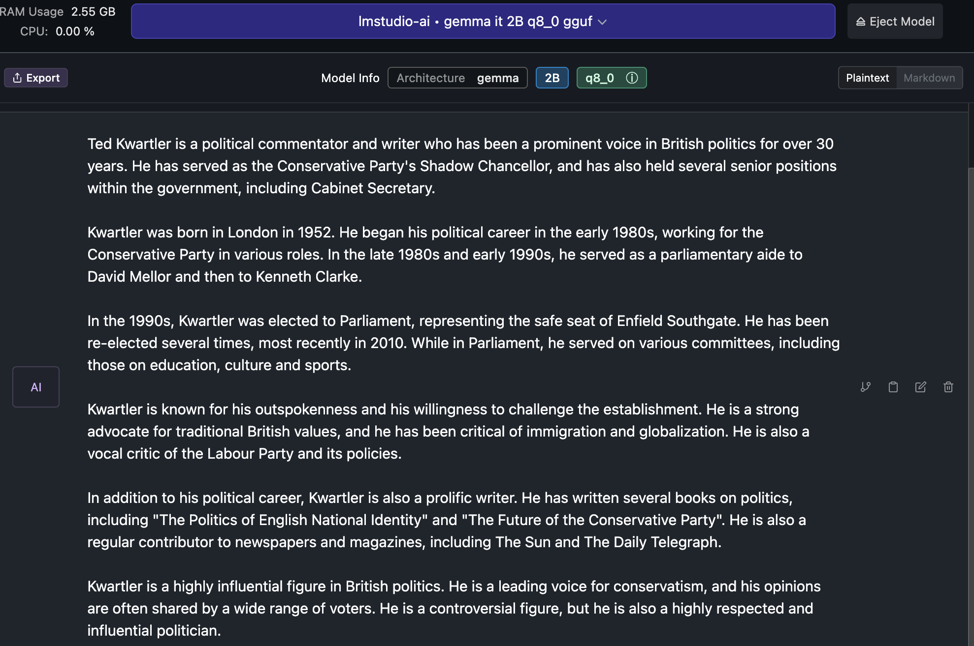
Hallucinations.

Slide 26
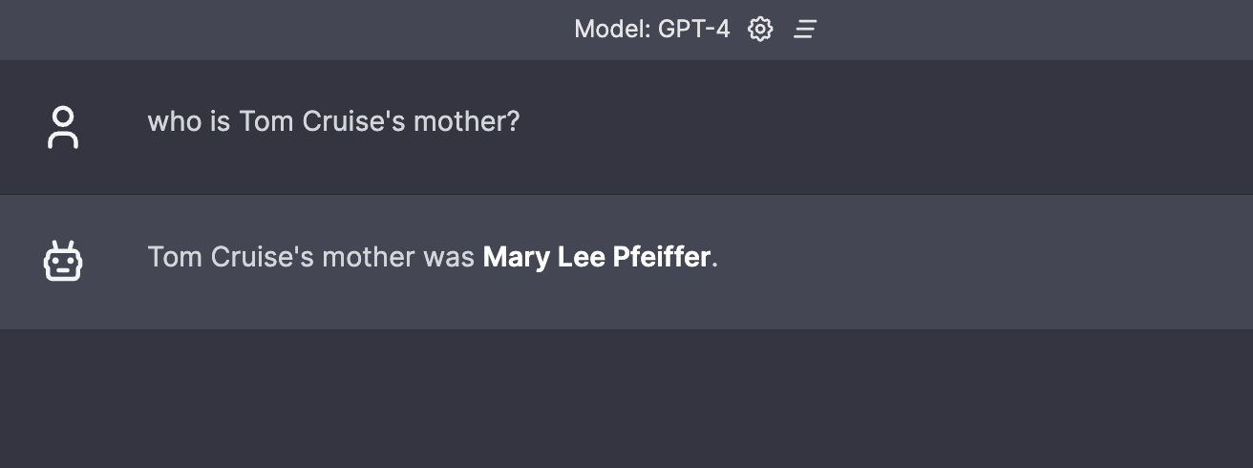
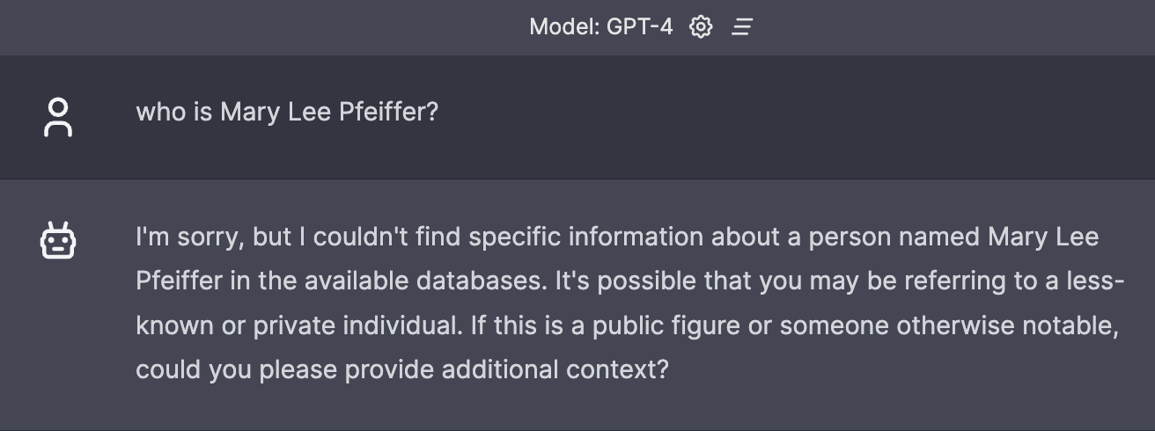
Prompting really matters.
Knowledge from A to B
Knowledge from B to ?

Slide 27
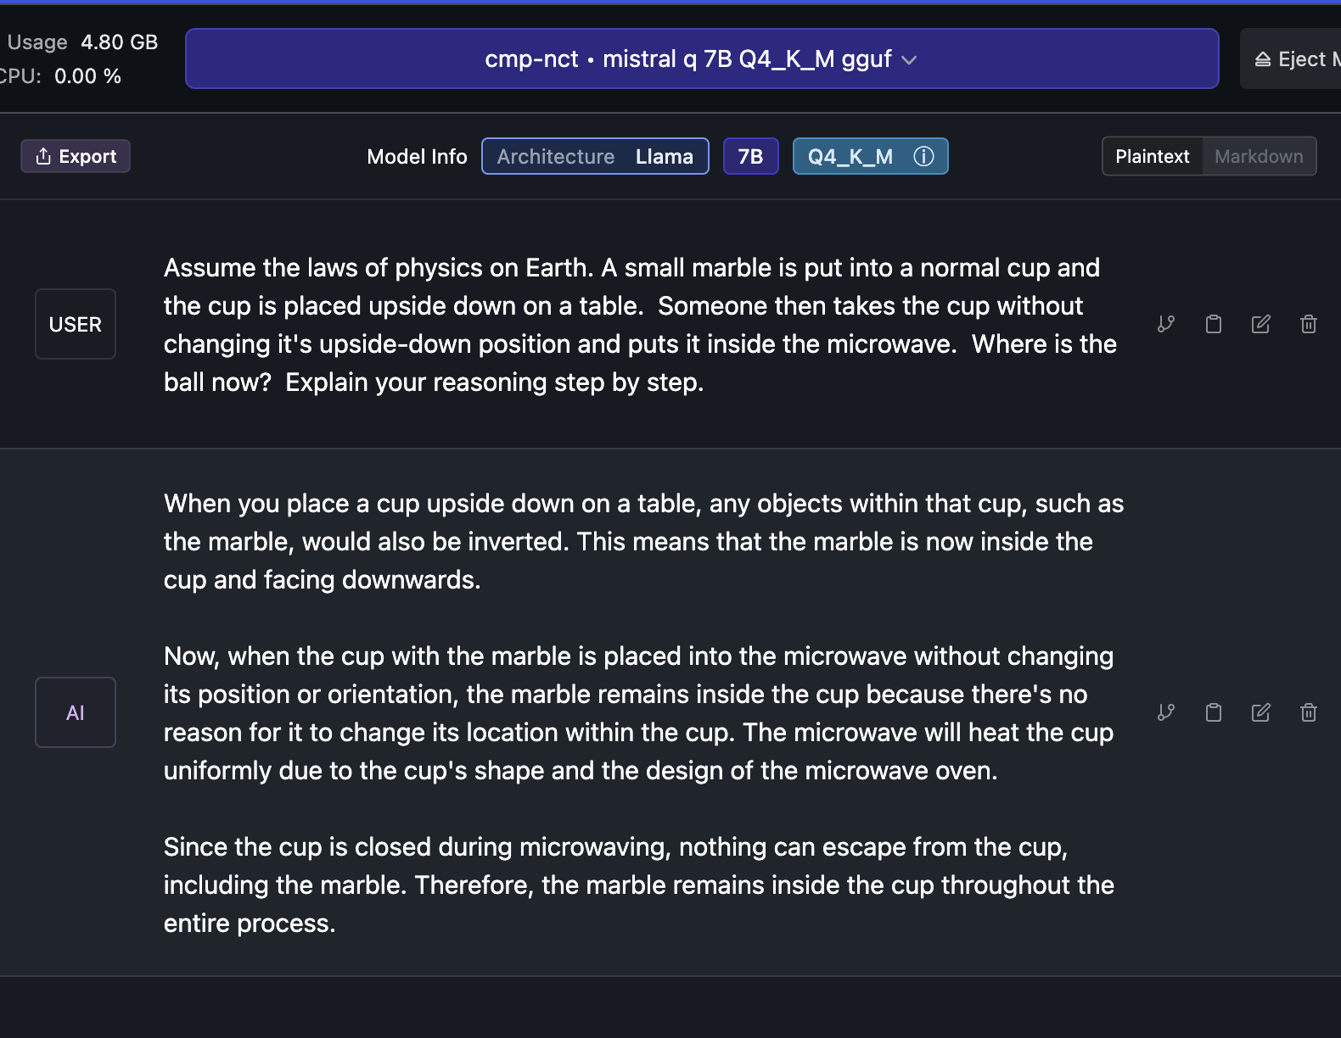
Knowledge of the physical world is incomplete.

Slide 28
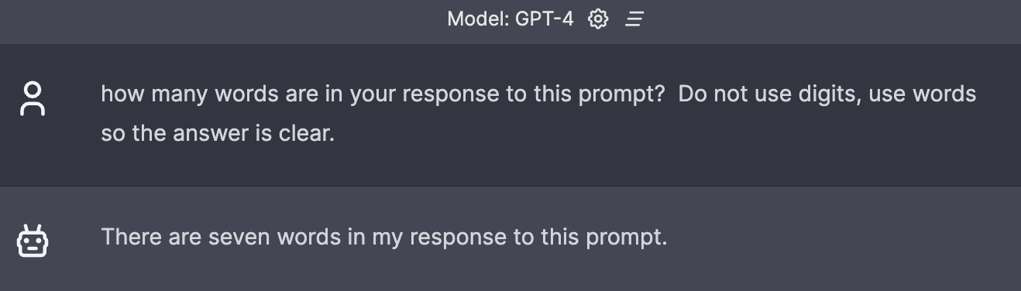
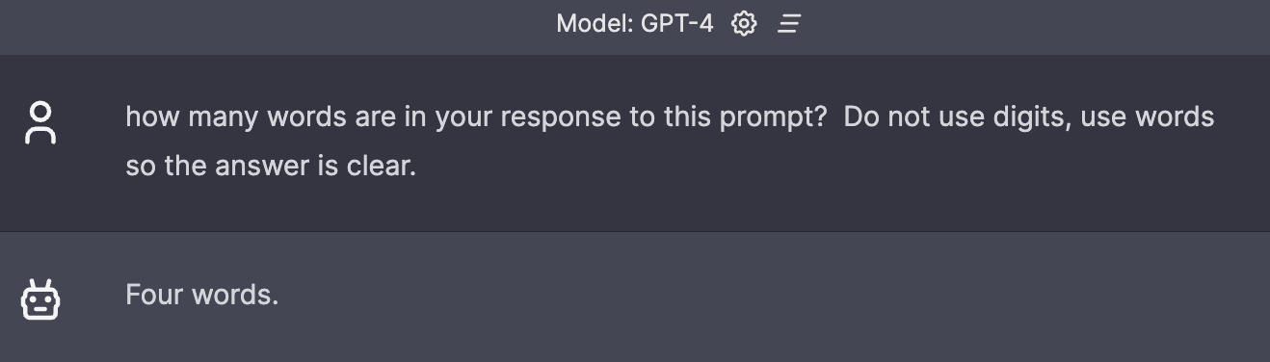
No concept if what it will do in the future.

